Slide 1
New restaurant in Moscow.
March, 2019

Slide 2
Predicting the place of the new restaurant
Moscow is a highly developing city. And new business centers and residential areas means that the district needs more social venues, including restaurants and cafés.
The subject of the evaluation - Northwest Administrative District.

Slide 3
Data source
Foursquare
Google Maps
Own base for districts

Slide 4
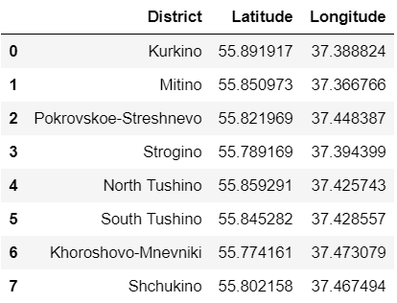
Areas within Northwest Administrative District

Slide 5
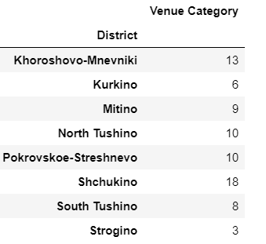
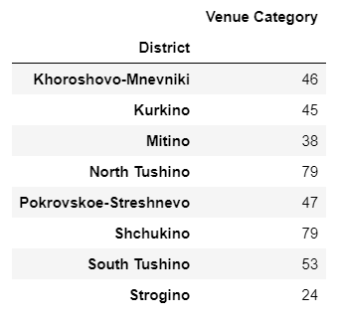
Number of Venues (all venues except Food and colleges vs. Food)

Slide 6
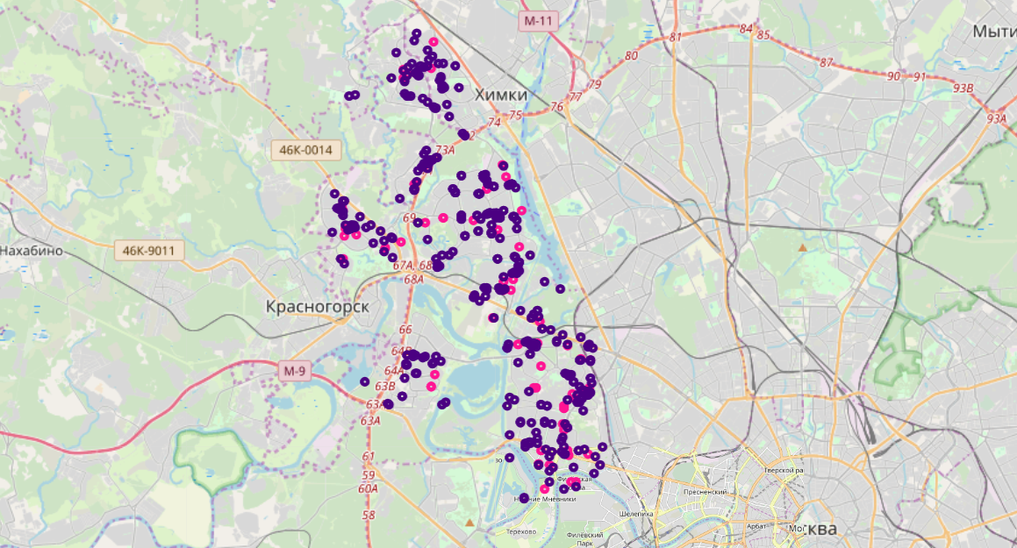
High competition
Lot’s of different ‘Food’ venues and few infrastructure objects which can generate the high demand → the competition could be quite rough.

Slide 7
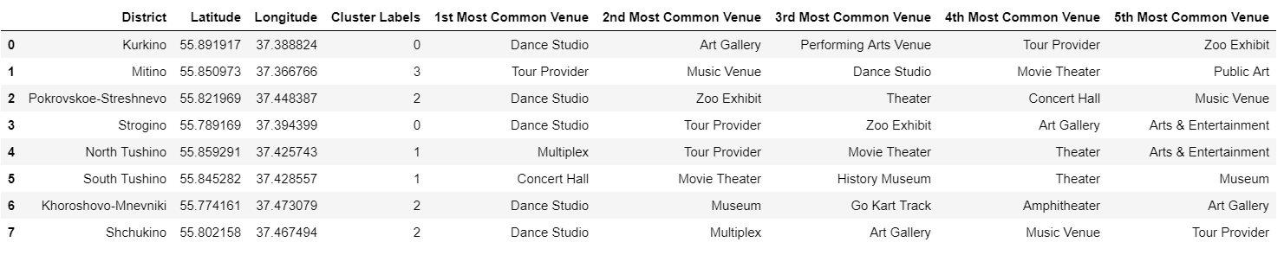
Clustering using k-mean (k=4)

Slide 8
Recommendations
Open the restaurant of the Cluster 3 (areas Pokrovskoe-Streshnevo, Khoroshovo-Mnevniki, Shchukino).
Among the top-values in the cluster are enough popular places such as museums, galleries etc. Comparing with other cluster it’s not so far from the city center, which may give additional benefits.

Slide 9
Discussion and conclusion
Review all other districts in the city for better prediction.
Use other statistical and geo databases as Foursquare seems to show not all list of existing values (local sources?).
Find the statistical data for the profitability of existing competitors by areas/districts (ideally for each legal entity).

